Slide 1
Design And Analysis of Algorithms Building a Sudoku Solving Application with Computer Vision and Backtracking
By
L.Keerthana(2010030512)
M.Manideepa(2010030517)
D.Dedeepya(2010030526)
K.Sriteja(2010030530)
Under the guidance of
UDAYARANI MA’AM

Slide 2
Problem statement and domain
The aim of the puzzle is to enter a numerical digit from 1 through 9 in each cell of a 9x9 grid made up of 3×3 subsquares or subgrids, starting with various digits given in some cells; each row, column, and subsquares region must contain each of the numbers 1 to 9 exactly once.
A sudoku solution must satisfy all of the following rules:-
1. Each horizontal row contains each digit exactly once
2. Each vertical column contains each digit exactly once
3. Each subgrid or region contains each digit exactly once

Slide 3
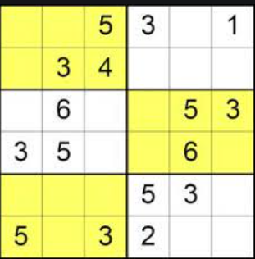
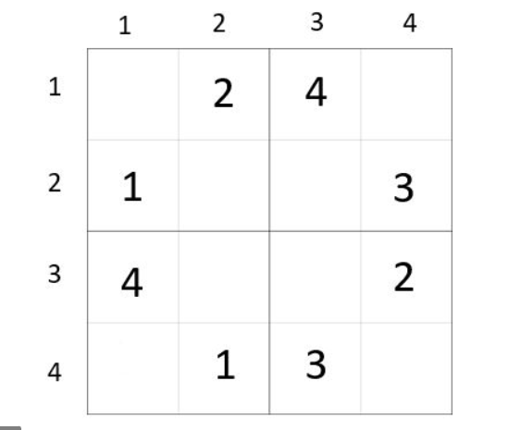
4x4 SUDOKU
6X6 SUDOKU
Small sudoku is propably the smallest and easiest sudoku variant
Grid size :- 4 x 4
Number of inner boxes :- 4
Inner box shape :- Sqaure
Number range :- 1 to 4
Mini sudoku is a relatively easy variant with non-square inner boxes.
Grid size :-6 x 6
Number of Inner boxes :- 6
Inner box shape :- 3 x 2 rectangle
Number range :- 1 to 6

Slide 4
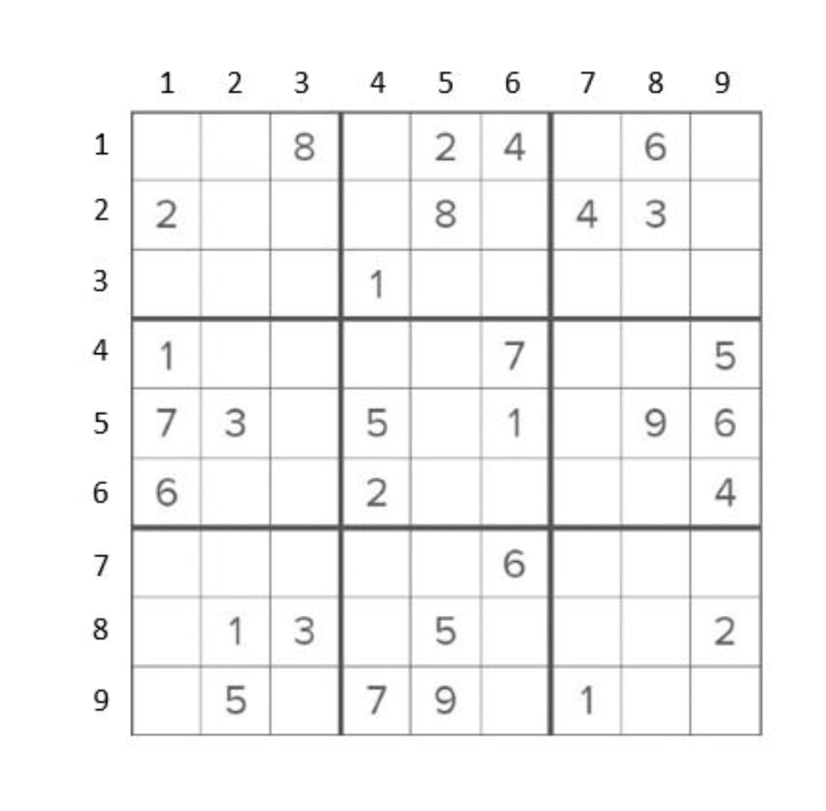
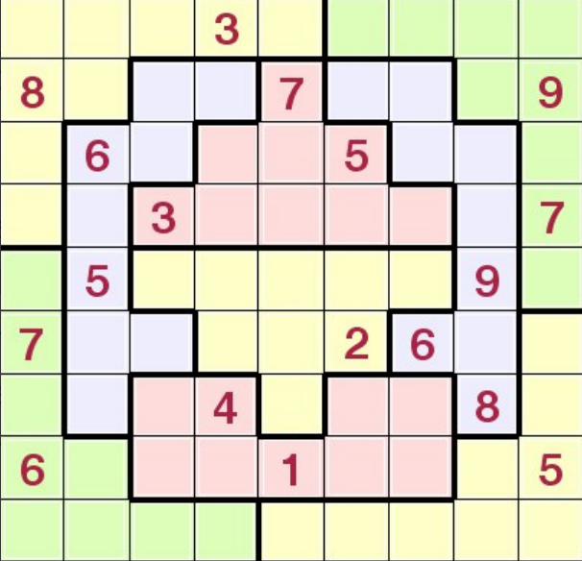
Standarad Sudoko
JIGSAW SUDOKO
Grid size :- 9 x 9
Number of inner boxes :- 9
Inner box shape :- 3 x 3 Sqaure
Number range :- 1 to 9
The only difference to the standard sudoku is the shape of the inner blocks
Grid size :- 9 x 9
Number of inner boxes :- 9
Inner box shape :- 3 x 3 Sqaure
Number range :- 1 to 9

Slide 5
Existing solutions
Sudoku puzzles are NP-complete problems and as such, their solution can be found by performing an exhaustive search.
1. Pen and Paper Algorithm :- a solution based on some strategies used by humans when solving the puzzle, therefore, it is called pencil-and-paper algorithm.
As there are puzzles with different types of difficulty, the easy and medium
puzzles can be solved using some simple techniques such as unique missing method, naked singles
2) Brute Force Search/BackTracking/Depth For Search :-
Backtracking checks every possible outcome that can occur on the board and is terminated when correct output occurs in one of these outcomes.
Backtråcking is also known as "Complete Brute Force Search" OR "Depth For Search Traversal Approach in Grid"

Slide 6
3) CROOKS ALGORITHM :-
Crooks algorithm, which is an imitation of pencil and paper algorithm, is a simple algorithm which we use to solve the sudoku on our own.
This algorithm sounds simple, but it has its limitations. Sometimes, we get incomplete answer to the sudoku because of multiple values that can occur on a particular empty space.

Slide 7
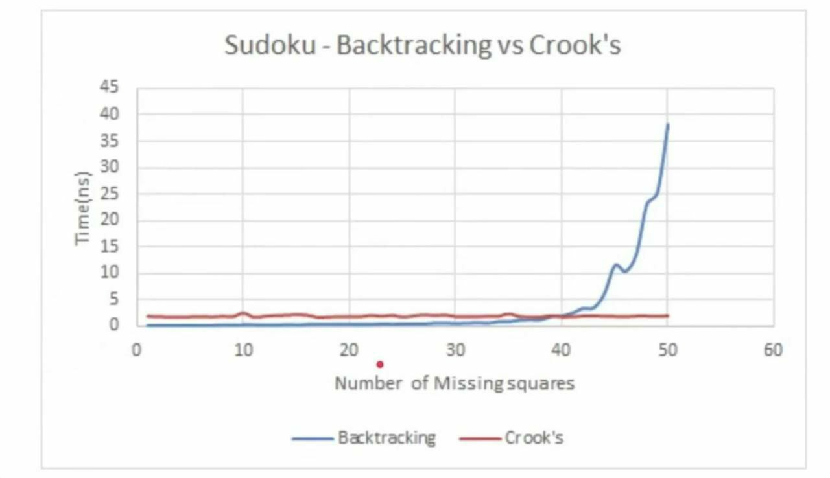
COMPARISION
According to the data, crooks algorithm is much faster than backtracking algorithm as it eliminates the impossible outcomes and then solves the algorithm, as compared to backtracking which generates all possible sudoku matrices which takes more time.
On the other hand, complete version of Crooks algorithm is that, solve the puzzle, and if it is incomplete, complete it with backtracking.

Slide 8
WHICH IS BEST ALGORITHM?
Crook's on its own is an incomplete algorithm, but it imitates solving by pencil and paper like us. It Might Get Stuck Somewhere due to Own Wrong Assumption
Backtracking checks all possible combinations but it provides correct solution. Although, it Takes More Time, But is Able to Provide Correct Answer
Best Algorithm => Backtracking Approach/ DFS Approach

Slide 9
Proposed Algorithm Design Technique
BACKTRACKING ALGORITHM :-
In simple terms, we first start with the first empty space on the sudoku board. We add the first element that can come in that space, let's say 1.
Next, we move on to the second empty space, and add the first element, 1, to it.
If this is valid, it will go to next space, or else the element will become 2. This repeats for every element that can be placed in that space.
This process is repeated for every empty space and if the sudoku is not solved, it goes to the first empty space and places next possible element, that is, 2, in our case.
This whole process is repeated until the sudoku is solved.

Slide 10
BACKTRACKING ALGORITHM
Find an empty cell with coordinates (row, col).
if no cell is found then
return true;
end
for digits x from 1 to 9 do
if we can place x at position (row,col) and the puzzle remains valid then recursively continue to fill the rest of the puzzle:
if recursion succeeds i.e. returns true then
return true
end
else
free cell and try with the next digit;
end
end
end
if none of the digits lead to a solution then
return false
end

Slide 11
BACKTRACKING –ANALYSIS
The time complexity for solving the sudoku is O(nm), where m = nxn. Where n is the number of squares in one side of the sudoku square. In classical sudoku, n = 9. Thus, time complexity for classical sudoku is 0(98¹).
The recurrence relation for backtracking algorithm for classical sudoku can be written as T(m) = 9*T(m-1) + 0(1)
This is because, we have to check 9 values in a particular empty space.

Slide 12
Data Structures needed
3D array or matrix
Sudoku is a 2D grid game; so this data structure comes in mind intuitively.
Mostly the operation involves reading the value of cell and writing value to the cell. So, these operations must be as fast as possible. With the use of 2D array, these operations will be O(1).
So this is the best data structure which we can use.
Assuming that you will use backtracking, you might check what are the possible values for a cell. To keep track of all values, you will store them. So it will be way easier to store them in Z-direction for each cell. Hence we need the third dimension.

Slide 13
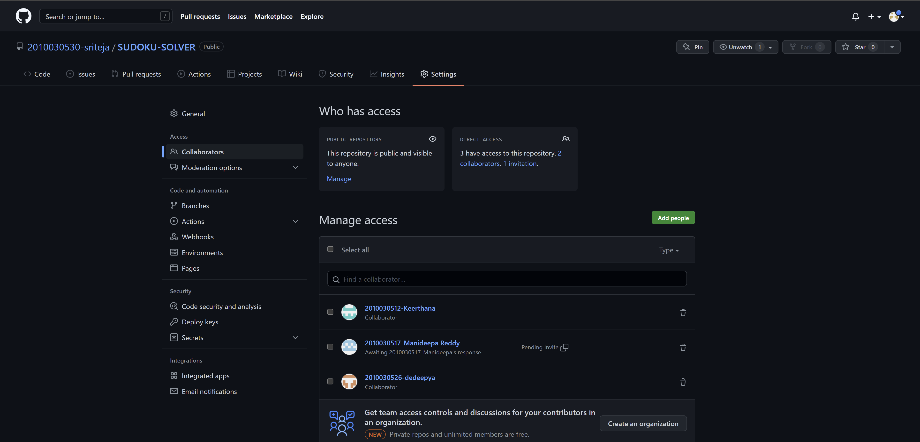
Github setup

Slide 14
Division of work among the group members
CODING AND TESTING – Sriteja ,Dedeepya
ALGORITHM AND FLOWCHART- Keerthana
ANALYZE DATA AND TECHNIQUES- Manideepa

Slide 15
THANK YOU…!!

